Slide 1
System Design For Blog Post
High Level Design.
Low Level Design.
Data Model Design.

Slide 2
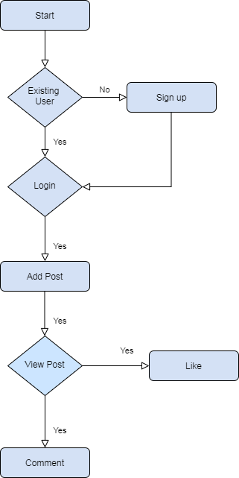
Use Case Flow Chart
Use Cases :
Sign up/Login.
Post Blog.
View Post.
Comment.
Like.

Slide 3
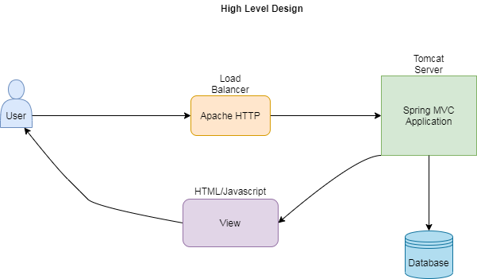
High Level Design :

Slide 4
High Level Design process
UI Technology : HTML, CSS, JavaScript, and images.
Backend : such as java, Spring Boot.
Configuration files, such as .properties, .yml and XML.
Build and dependency management : such as Maven POM,
Gradle, and ANT.

Slide 5
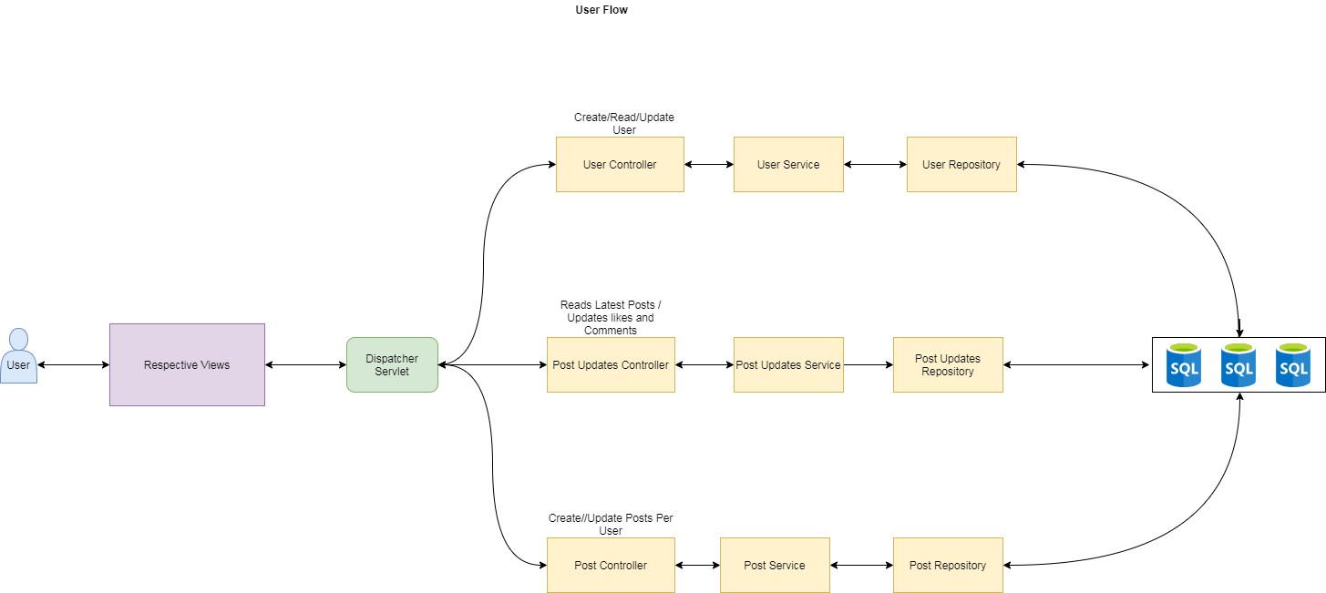
Use Case Flow :

Slide 6
Use Case Flow :
User : The user can log in and create/update the user information, the user service can trigger and complete the business logic for user creation.
Post : After successful login, user can add a new post in the activity feed.
View Posts : The application has an activity feed that displays all the posts and the post controller is responsible for this activity, the user can scroll to load more posts.
Post Comment/Like : In the activity feed the user can comment on any post/like that is displayed provided the user is logged in.

Slide 7
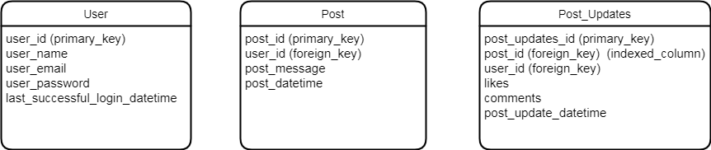
Data Model Design :

Slide 8
Data Model:
The User table holds the user information.
Every user can post in the forum, those post/feedback texts are
stored in the post table.
The user can view the posts in the activity feed, latest posts are
fetched from the post table and displayed.
User comments and likes are stored in the Post Updates table
which can be retrieved per post id.

